Slide 1
CREDIT RISK MODELING USING XGBOOST IN PYTHON
by Sandy Vo
Date: Apr 13th 2024

Slide 2
Introduction
Project objective: develop a predictive model to assess credit risk based on credit_data__2_.Xls dataset.
Data cleaning: clean and preprocess data to ensure quality inputs for the model, including handling missing values and encoding categorical variables.
Exploratory data analysis (EDA): perform comprehensive EDA to understand the underlying patterns, correlations, and distributions in the data. This includes visualizing relationships, identifying anomalies, and summarizing key features.
Methodology: utilize XGBOOST, an advanced machine learning algorithm known for its performance and speed.
Model training: train the XGBOOST model using a dataset of loan applicants, optimizing for accuracy and robustness.
Validation and testing: apply cross-validation techniques to evaluate model performance and prevent overfitting.
Outcome: aim to achieve a model that reliably predicts the probability of default, enhancing decision-making in credit approvals.

Slide 3
Data cleansing and transforming
Importing Libraries and loading data
Checking Duplicate rows, Missing Values and Unique Values
Statistic Metrics for Numeric Variables
Transforming variables
4.1. Transforming numeric variables
4.2. Transforming categorical variables

Slide 4
Transforming numeric variables
Despite INSTALL_RATE, NUM_CREDITS and NUM_DEPENDENTS being classified as numeric, they contain less then 5 distinct values => convert them into categorical variables as outlined below.
Var. # | Variable Name | Description | Variable Type | Code Description
1 | NUM_CREDITS | Number of existing credits at this bank | Categorical | 1: <= 1 2: 2 3: 3 4: >=4
2 | NUM_DEPENDENTS | Number of people for whom liable to provide maintenance | Categorical | 1: <=1 2: >=2
3 | INSTALL_RATE | Installment rate as % of disposable income | Categorical | 1: <= 1 2: 1< ... <= 2 3: 2< ... <=3 4: >3

Slide 5
Transforming categorical variables
1. Consolidate "MALE_DIV", "MALE_SINGLE", and "MALE_MAR_or_WID" into a single column “LIFE_STATUS” that represents both gender and marital status. LIFE_STATUS takes 4 values:
1: divorced male
2: single male
3: married male/widow
0: others
2. Consolidate 'NEW_CAR', 'USED_CAR', 'FURNITURE', 'RADIO/TV', 'EDUCATION', and 'RETRAINING' into a single column “LOAN_PURPOSE” that represents loan purpose. LOAN_PURPOSE takes 7 values:
1: new car
2: used car
3: furniture
4: radio/tv
5: education
6: retraining
0: others

Slide 6
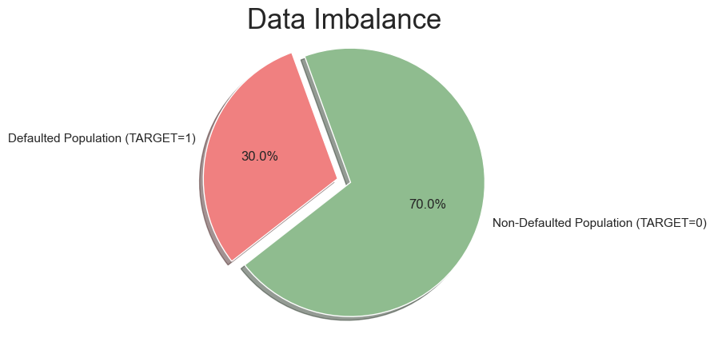
Checking Imbalance for DEFAULT variable
Since there is a huge imbalance between the DEFAULT variable 0 (70%) and 1 (30%), it makes more sense to divide data frame into 2 sub datasets then continue our analysis.
In order to analyze the imbalance and various aspects of data we will perform various types of analysis such as:
Univariate analysis
Bivariate analysis
Multivariate analysis

Slide 7
EDA (Explanatory Data Analysis)

Slide 8
Univariate/Bivariate Analysis Categorical variables

Slide 9
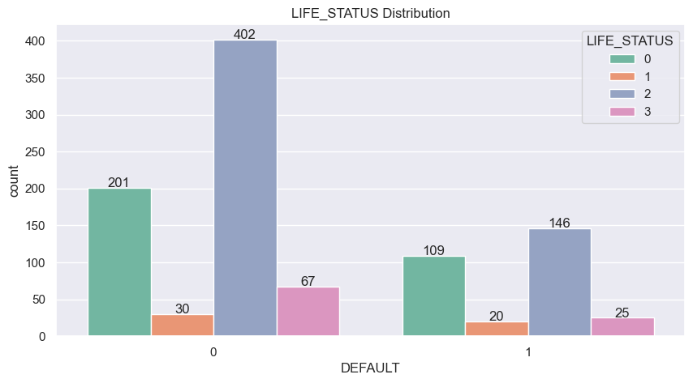
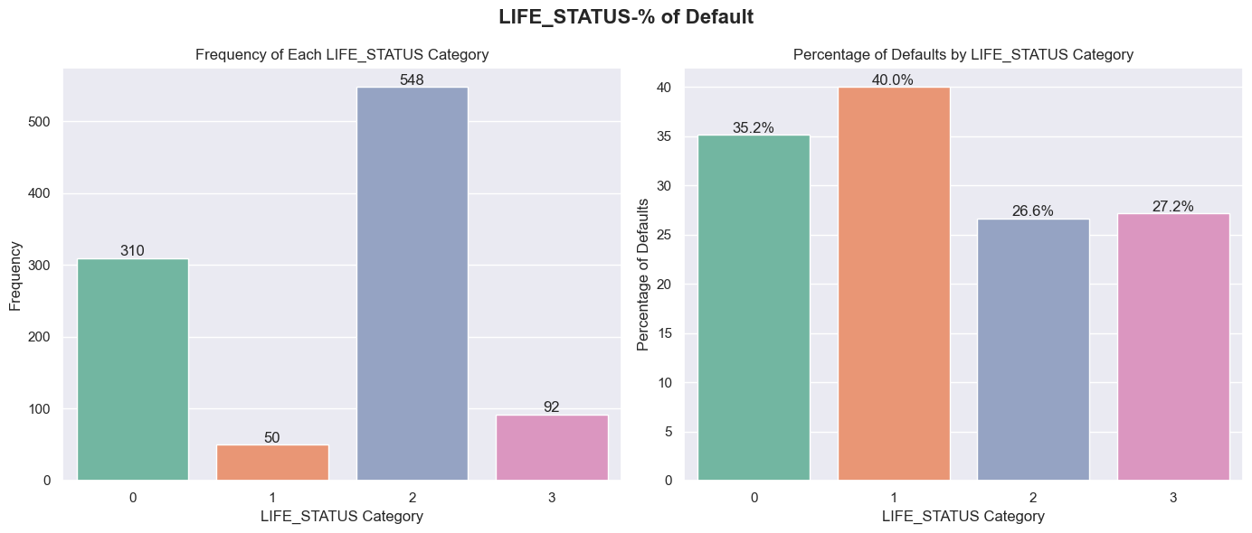
Life status vs Default
Divorced Male applicants have applied the least (50 out of 1000 records) and also became the highest group being default (40%).
Single Male seemed to be the most struggling group accounting for 50% of the whole sample) but they are surprisingly the best group with the lowest default rate.
Description:
1: Male and Divorced
2: Male and Single
3: Male and Married or Widow
0: Others

Slide 10
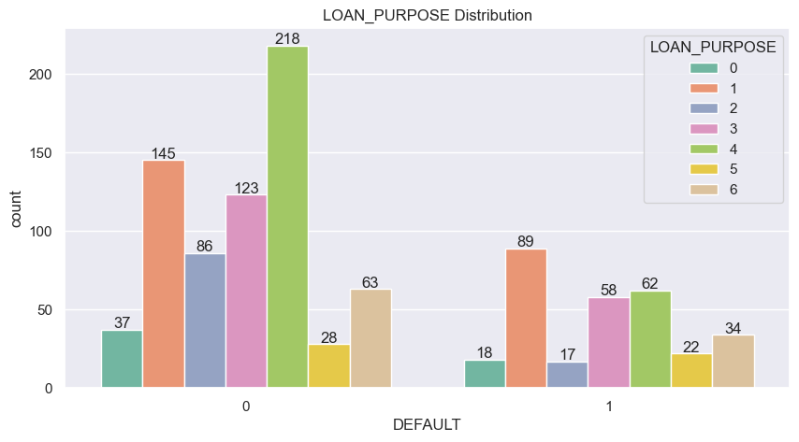
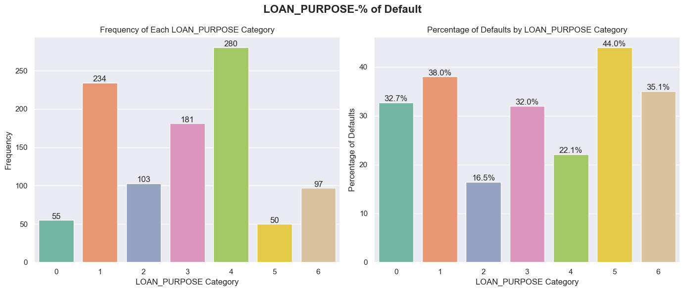
Loan Purpose vs DEFAULT
Loan used for Education has contributed the least (50 records out of 1000) but surprisingly were the worst group with 44% being default.
Loan used for Radio/TV purchase was applied the most (25% of the whole application sets) but being the best second group with only 22.1% being default.
Loan used for New Car is the second highest group after Radio/TV group and has been the second worst group with the default rate of 38%.
Description:
1: NEW_CAR
2: USED_CAR
3: FURNITURE
4: RADIO/TV
5: EDUCATION
6: RETRAINING
0: OTHERS

Slide 11
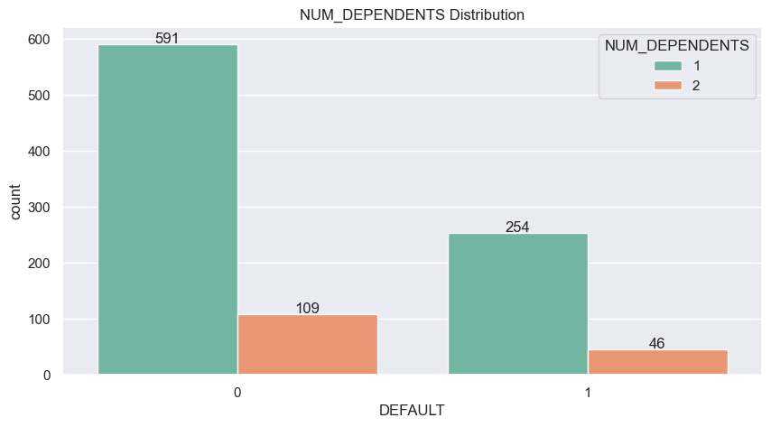
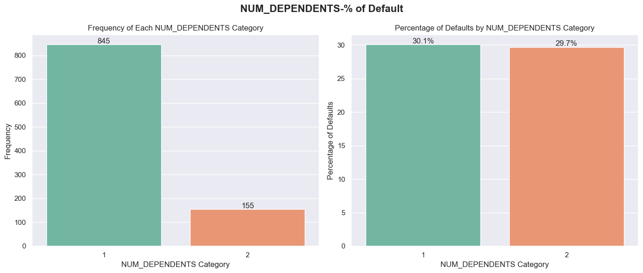
Number of Dependents vs Default
85% of the individuals in the sample have only one dependent; the remaining 15% have two dependents.
Both groups exhibit similar default rates, estimated at around 30%.
The similarity in default rates suggests that the 'Number of Dependents' feature is likely to have negligible predictive power.

Slide 12
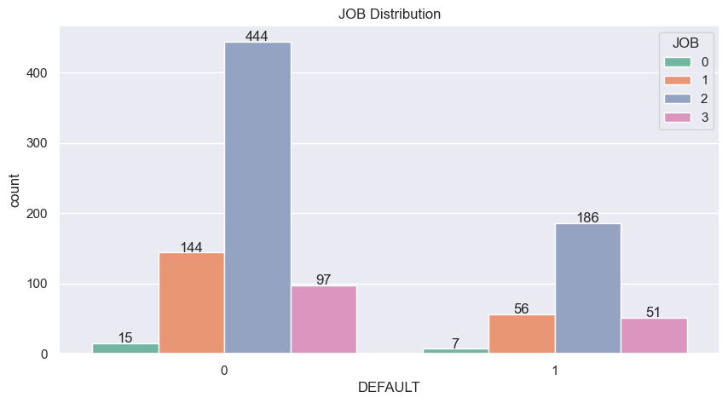
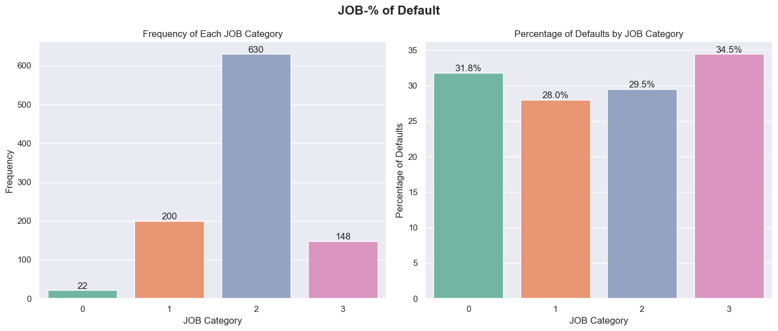
Job type vs Default
Unemployed/Unskilled non-resident and Senior/Management level or Self-employed were the least groups (22 and 148 applicants respectively) but obtained the highest default rates (31.8% and 34.5% respectively).
However, the 4 groups of job types has approximately default rates ranging from 28% to 34.5%, so Job type is expected to be a variable with very weak prediction impact.
Description:
0: unemployed/ unskilled – non-resident
1: unskilled – resident
2: skilled employee/ official
3: management/ self-employed/ highly qualified employee/ officer

Slide 13
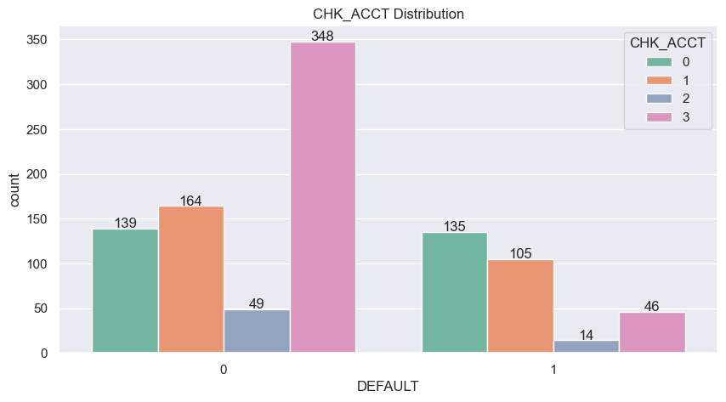
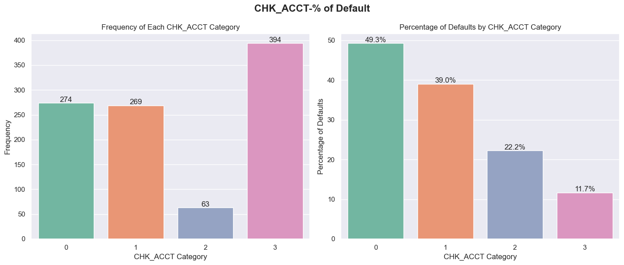
Number of existing credits vs DEFAULT
Those who did not have checking account applied the most but being the best group with only 11.7% default rate.
The higher balance in checking acct was, the less possibility of being default.
Description:
0: <0
1: 0< …. < 200
2: >= 200
3: no checking acct

Slide 14
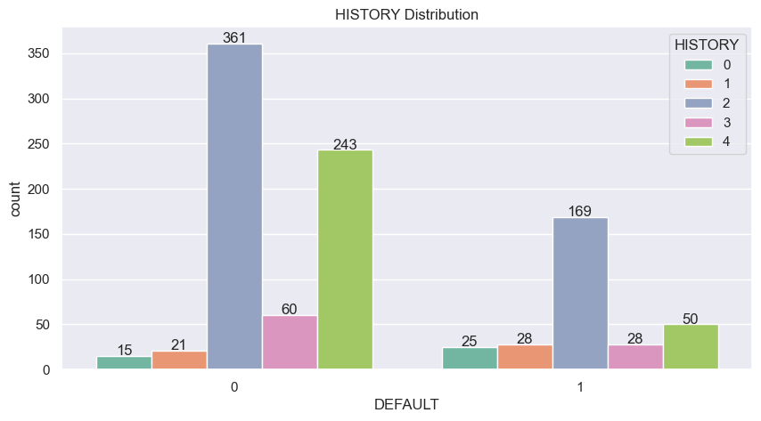
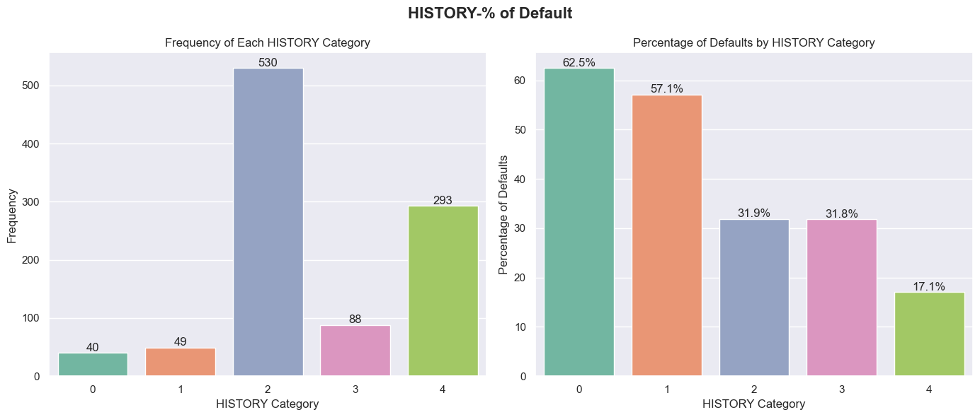
Credit history vs DEFAULT
The group with no prior credit history exhibits the highest default rate at 62.5%, suggesting potential risk in lending to new borrowers.
Borrowers with delayed past payments and those with critical accounts have significantly different default rates of approximately 31.9% and 17.1%, respectively, indicating that past payment delays do not necessarily predict future defaults.
Surprisingly, individuals who have duly paid all credits at this bank are among the higher default risk group at 57.1%, which may imply that a good history with the bank does not guarantee future credit reliability.
Description:
0: no credits taken
1: all credits at this bank paid back duly
2: existing credits paid back duly till now
3: delay in paying off in the past
4: critical account

Slide 15
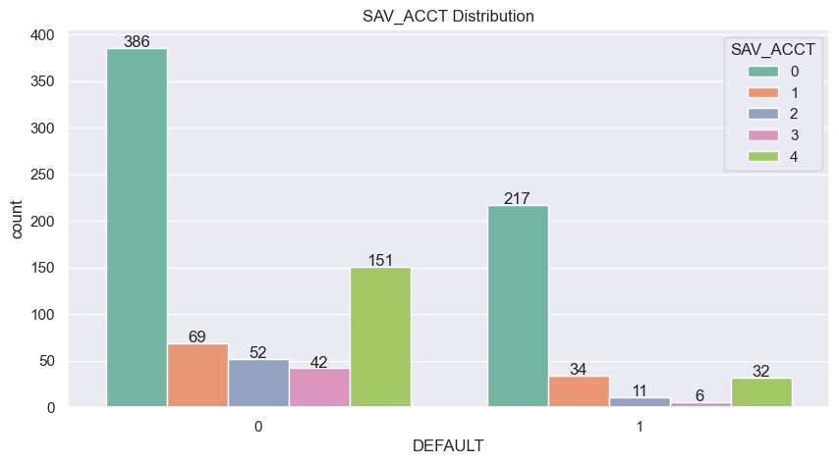
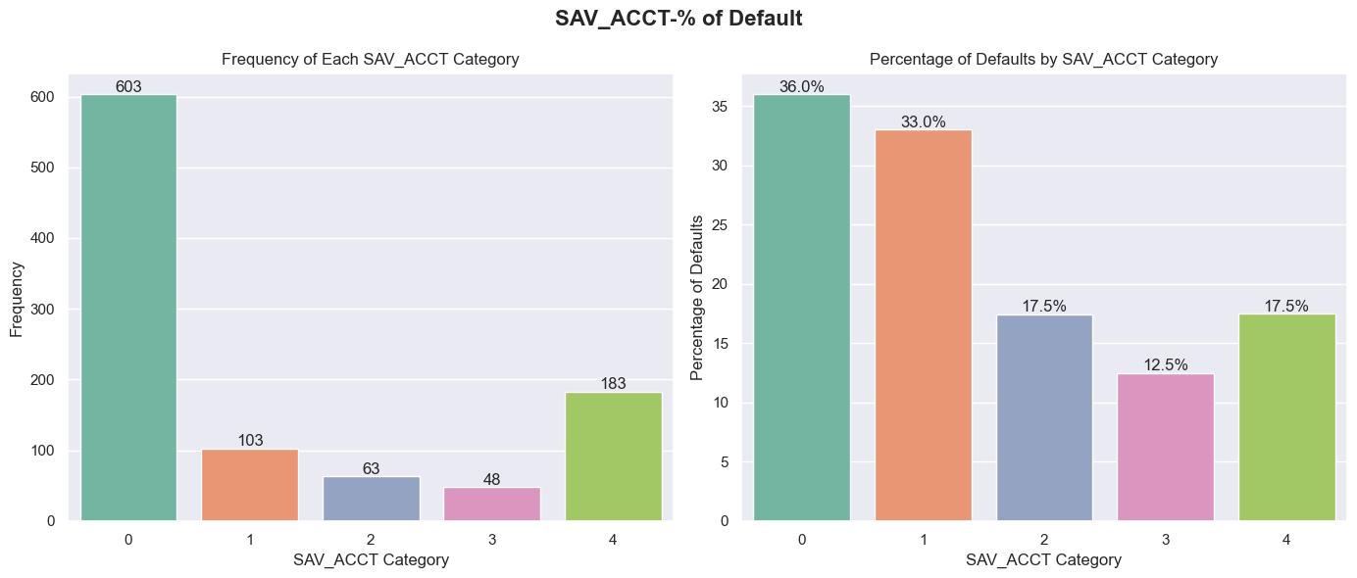
Saving AccOUNt vs DEFAULT
Individuals with unknown or no savings account status represent the highest default rate at 36%, suggesting a strong correlation between the absence of savings and increased credit risk.
Surprisingly, account holders with less than $100 in savings have a slightly lower default rate at 33%, followed by those with $500 to under $1000, indicating a potential non-linear relationship between savings account balances and default risk.
Customers with savings of $100 to under $500, and those with balances of $1000 or more, show significantly lower default rates of 17.5% and 12.5%, respectively, indicating a lower risk of default among these groups.
Description:
0 : < 100
1 : 100<= ... < 500
2 : 500<= ... < 1000
3 : =>1000
4 : unknown/ no savings account

Slide 16
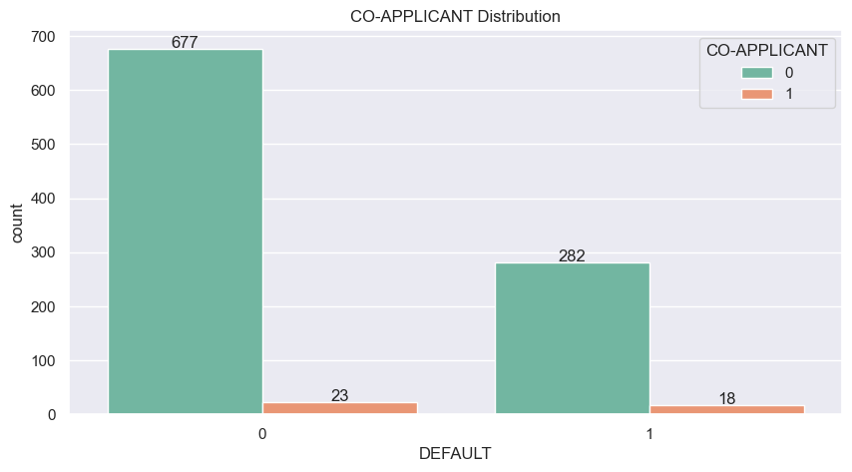
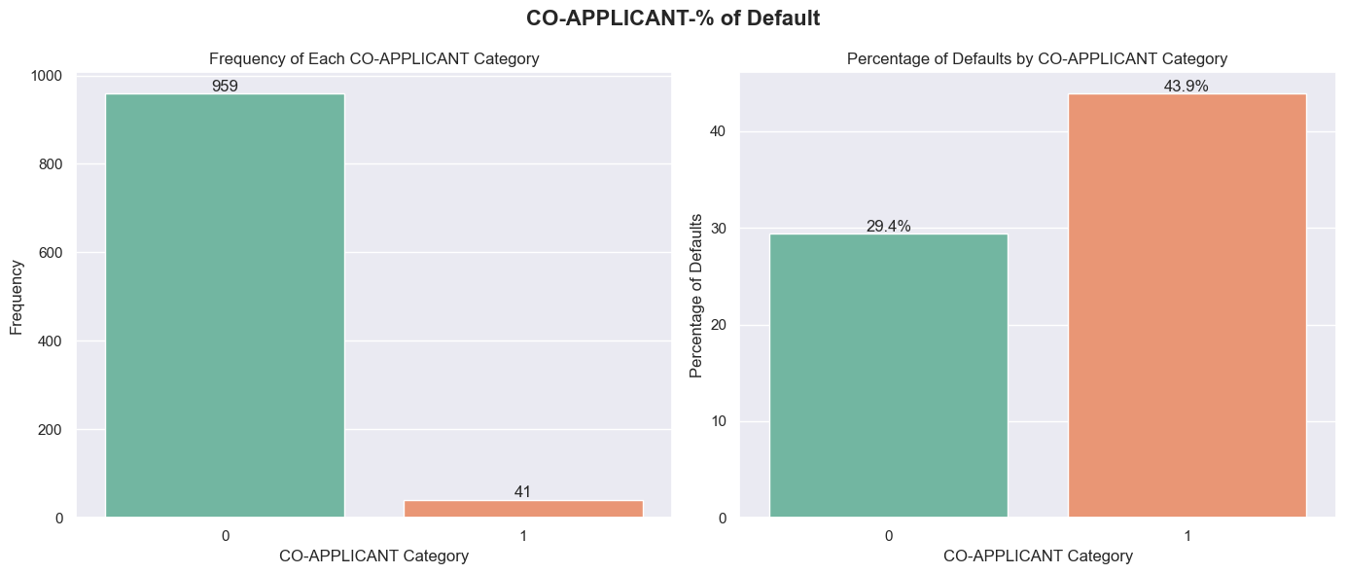
CO-APPLICANT vs DEFAULT
A vast majority of the loan applications in the sample, 959 out of 1000, do not have a co-applicant, dominating the dataset.
Loan applications without a co-applicant have a default rate of 29.4%, indicating that nearly a third of these applicants default on their loans.
Significantly, applications with a co-applicant show a much higher default rate of 43.9%, suggesting that having a co-applicant may be associated with a higher risk of default.
Description:
Whether an application has a co-applicant
0: No
1: Yes

Slide 17
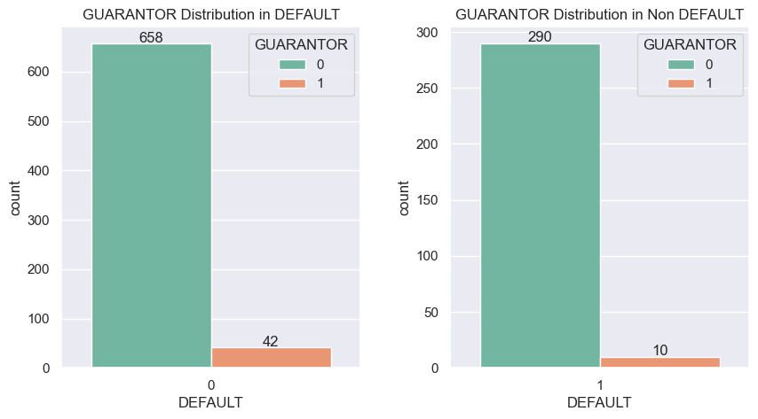
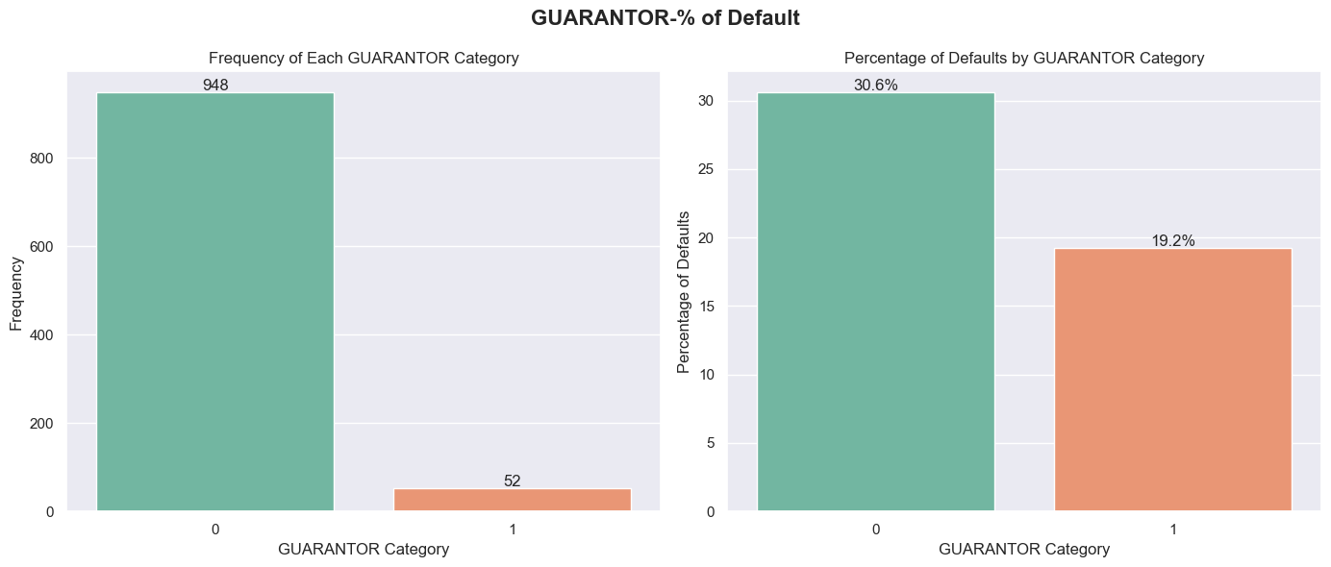
Guarantor vs default
The majority of applicants, 948 out of 1000, do not have a guarantor, and this group sees a default rate of 30.6%.
Conversely, applicants with a guarantor, representing a small fraction of the total, show a significantly lower default rate at 19.2%, indicating the potential positive impact of having a guarantor on loan repayment reliability.
Description:
Whether an application has a guarantor
0: No
1: Yes

Slide 18
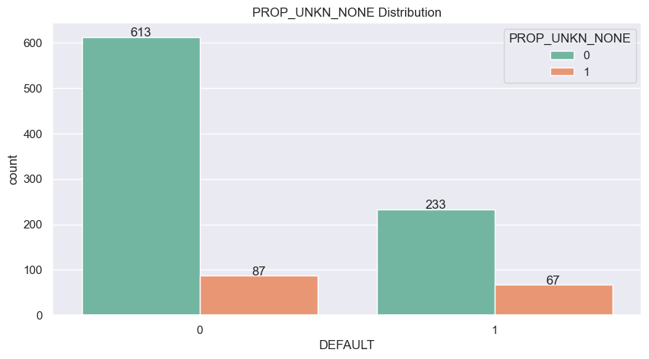
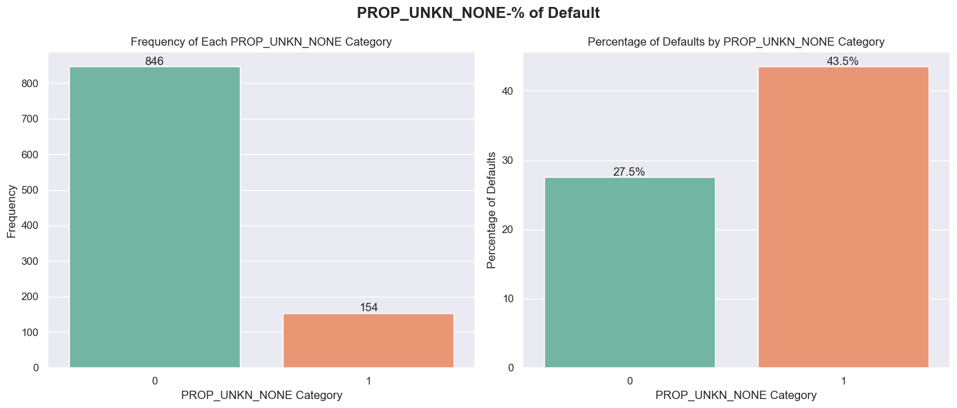
PROP_UNKN_NONE vs default
Description:
Whether an applicant owns no property (or unknown)
0: No
1: Yes
The majority of applicants, 846 out of 1000, are identified as owning property, with a lower default rate of 27.5%.
A smaller subset of applicants, 154 in total, either do not own property or it's unknown, and they exhibit a significantly higher default rate of 43.5%.
This contrast suggests that property ownership, or the lack thereof, could be a significant factor in predicting loan defaults.

Slide 19
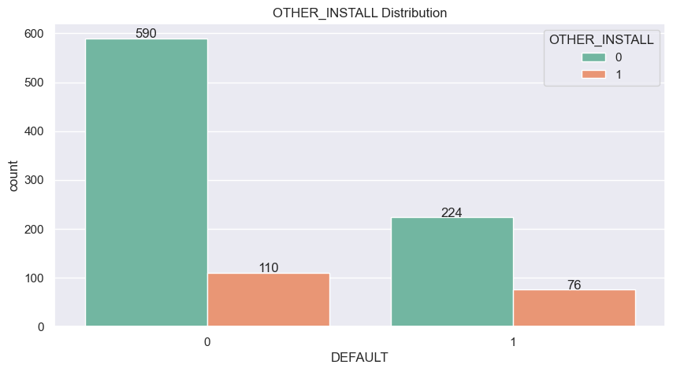
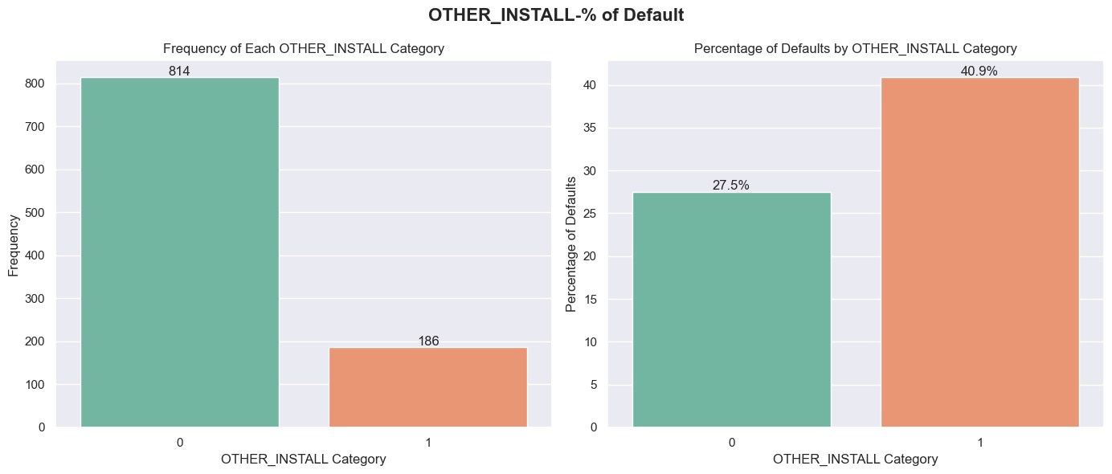
OTHER_INSTALL vs default
Most of the sample population, accounting for 814 individuals, does not have any other installment plan credit, showing a default rate of 27.5%.
A smaller portion of the sample, 186 individuals, has other installment plan credit and experiences a significantly higher default rate of 40.9%.
The data suggests that having additional installment plans is associated with a higher likelihood of defaulting on credit.
Description:
Whether an applicant has other installment plan credit
0: No
1: Yes

Slide 20
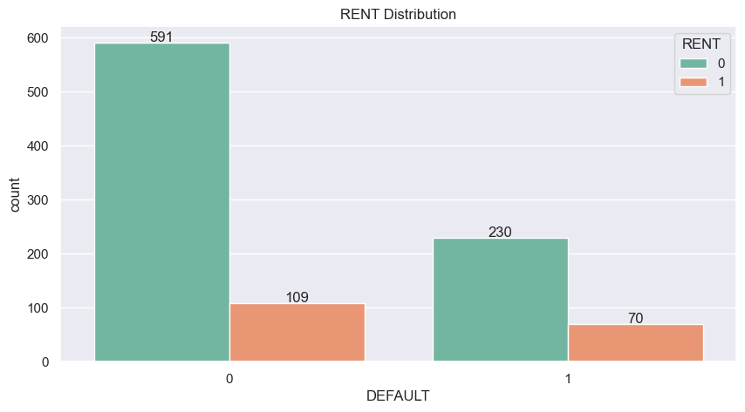
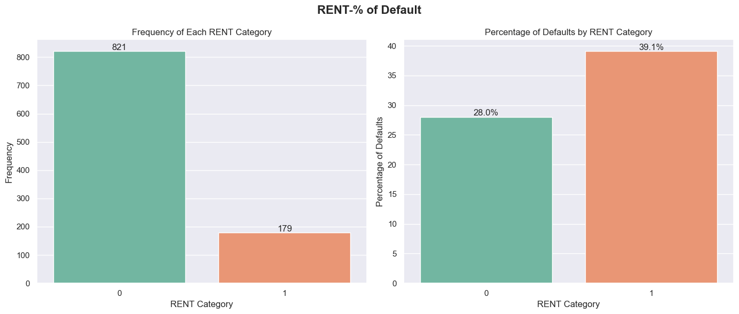
RENT vs default
A significant majority, 821 applicants, do not rent their place of living, with these applicants experiencing a default rate of 28%.
A smaller portion, 179 applicants, are renters, and this group has a notably higher default rate of 39.1%.
The data indicates that applicants who rent their homes may be more likely to default on loans compared to those who do not rent..
Description:
Whether an applicant rents
0: No
1: Yes

Slide 21
Univariate Analysis Numerical

Slide 22
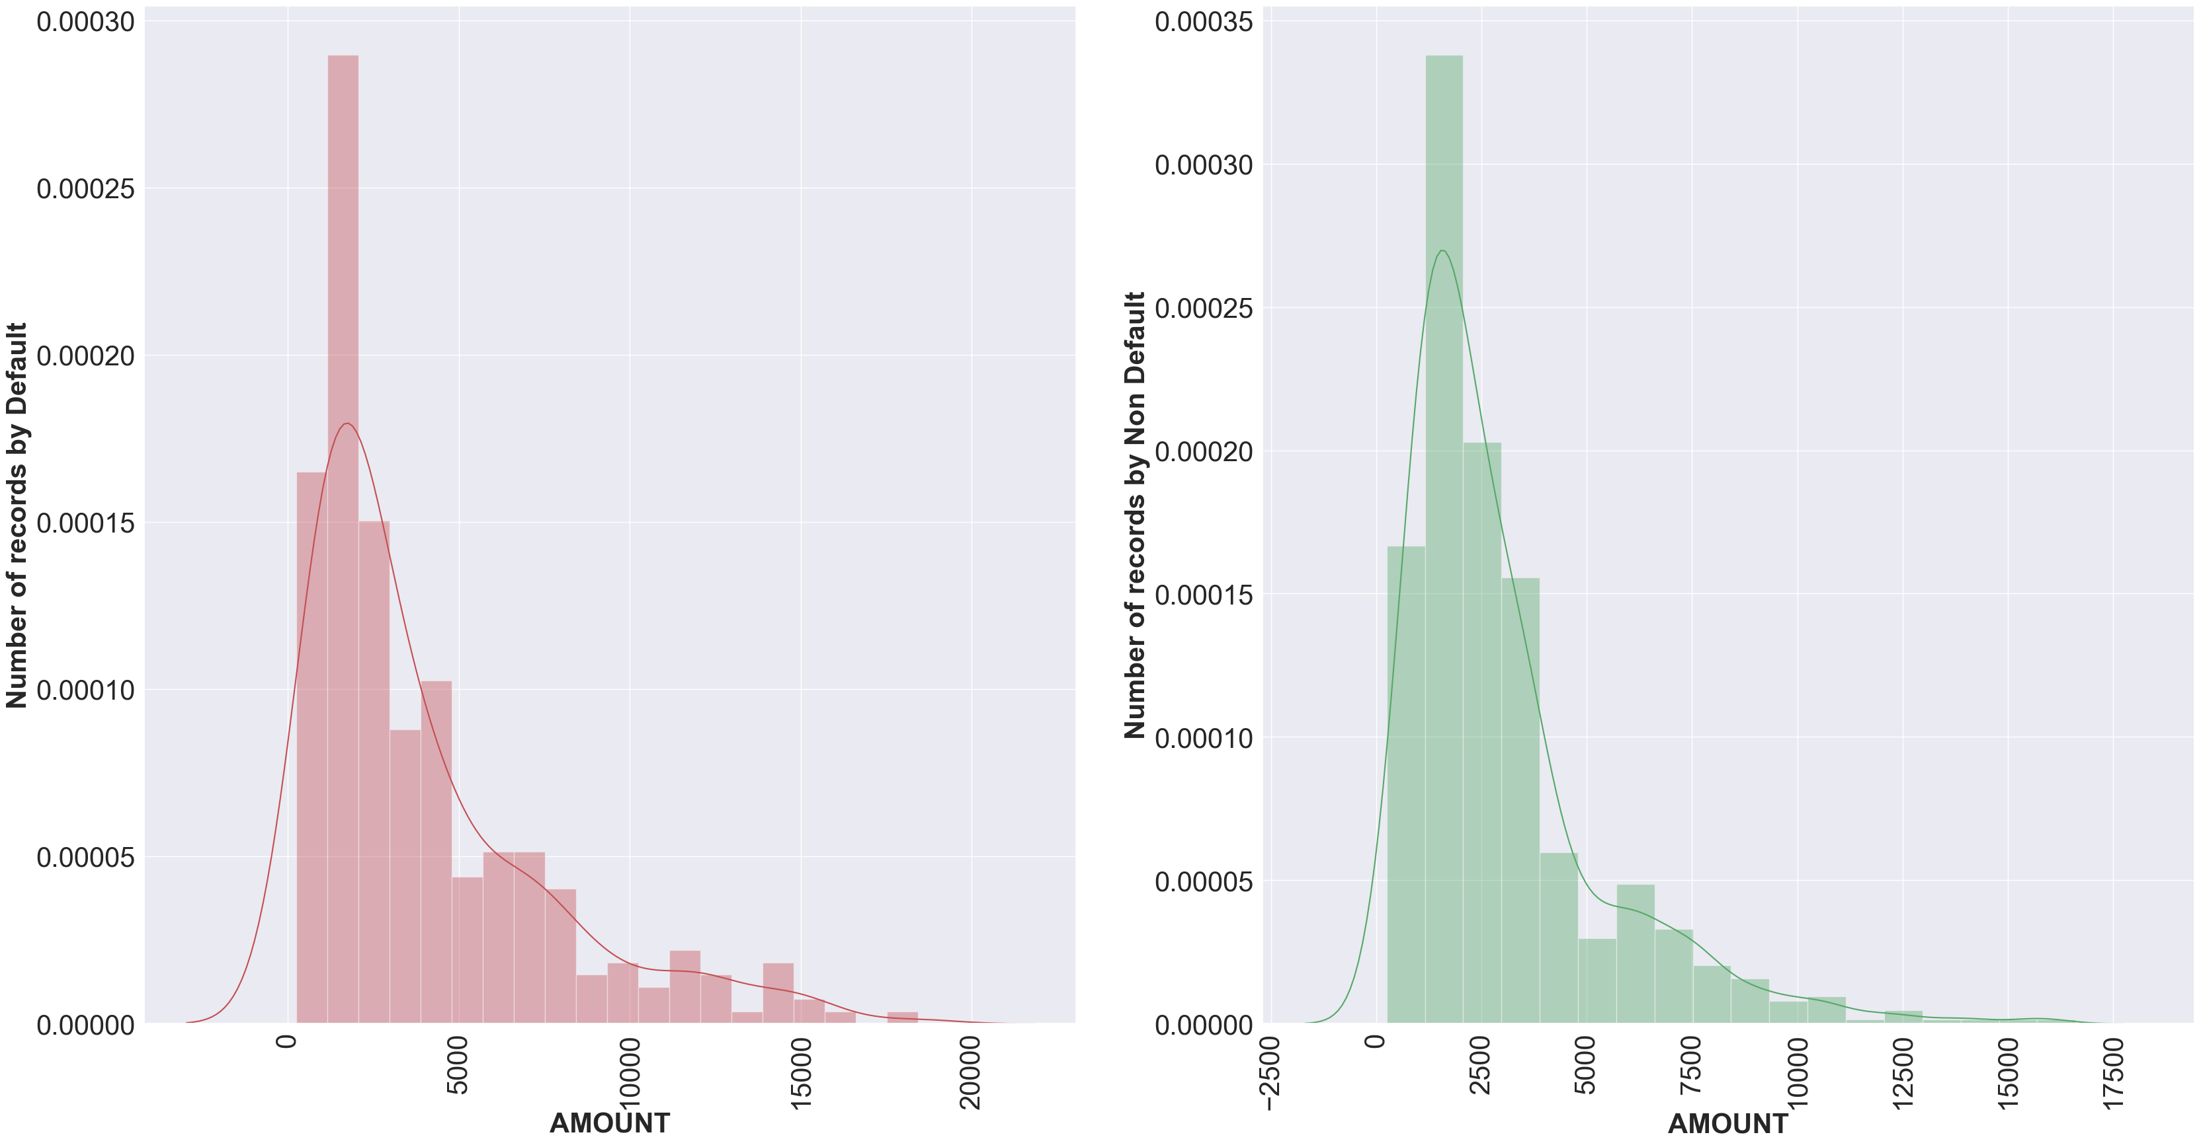
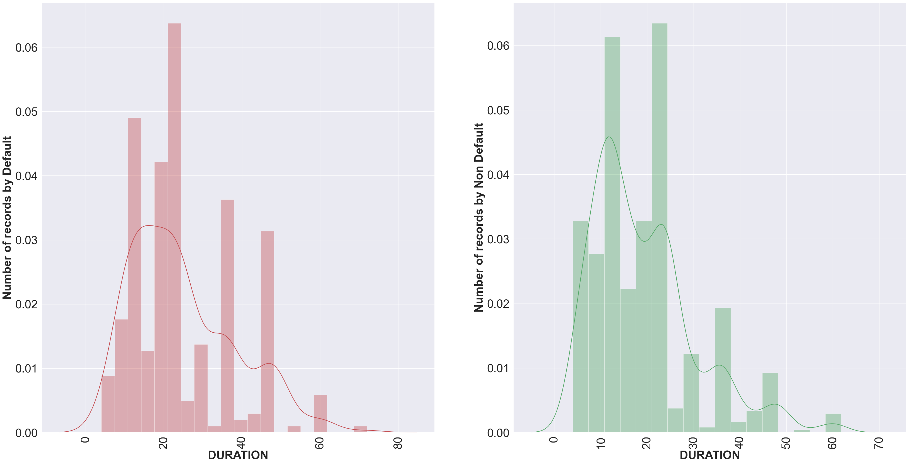
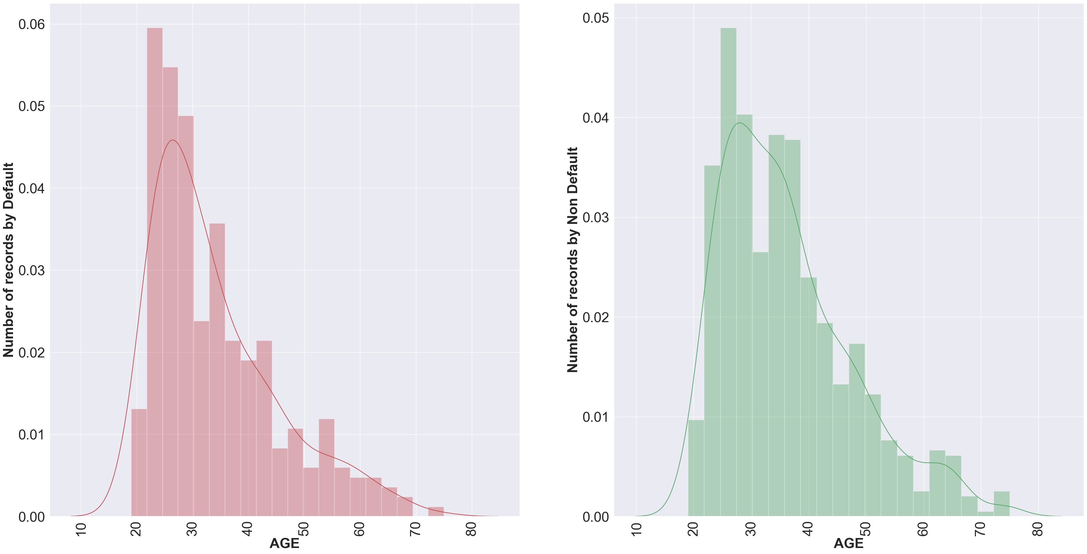
DURATION/AMOUNT/AGE VS DEFAULT
Duration of Loan: Defaulting customers tend to have loans with shorter durations, peaking around 10-20 months, whereas non-defaulting customers have a more evenly distributed duration ranging up to 60 months.
Loan Amount: For defaulting customers, there's a significant peak at the lower loan amounts, indicating a higher frequency of defaults with smaller loans. Non-defaulting customers have a broader distribution of loan amounts with a less pronounced peak, suggesting that loan amount alone is not a strong indicator of default.
Applicant Age: The age distribution for defaulting customers skews younger, with a notable peak below age 30. Non-defaulting customers have a more spread out age distribution, indicating that a broader range of ages are represented in the non-defaulting category, though still peaking in the younger age groups.

Slide 23
MULtivariate Analysis

Slide 24
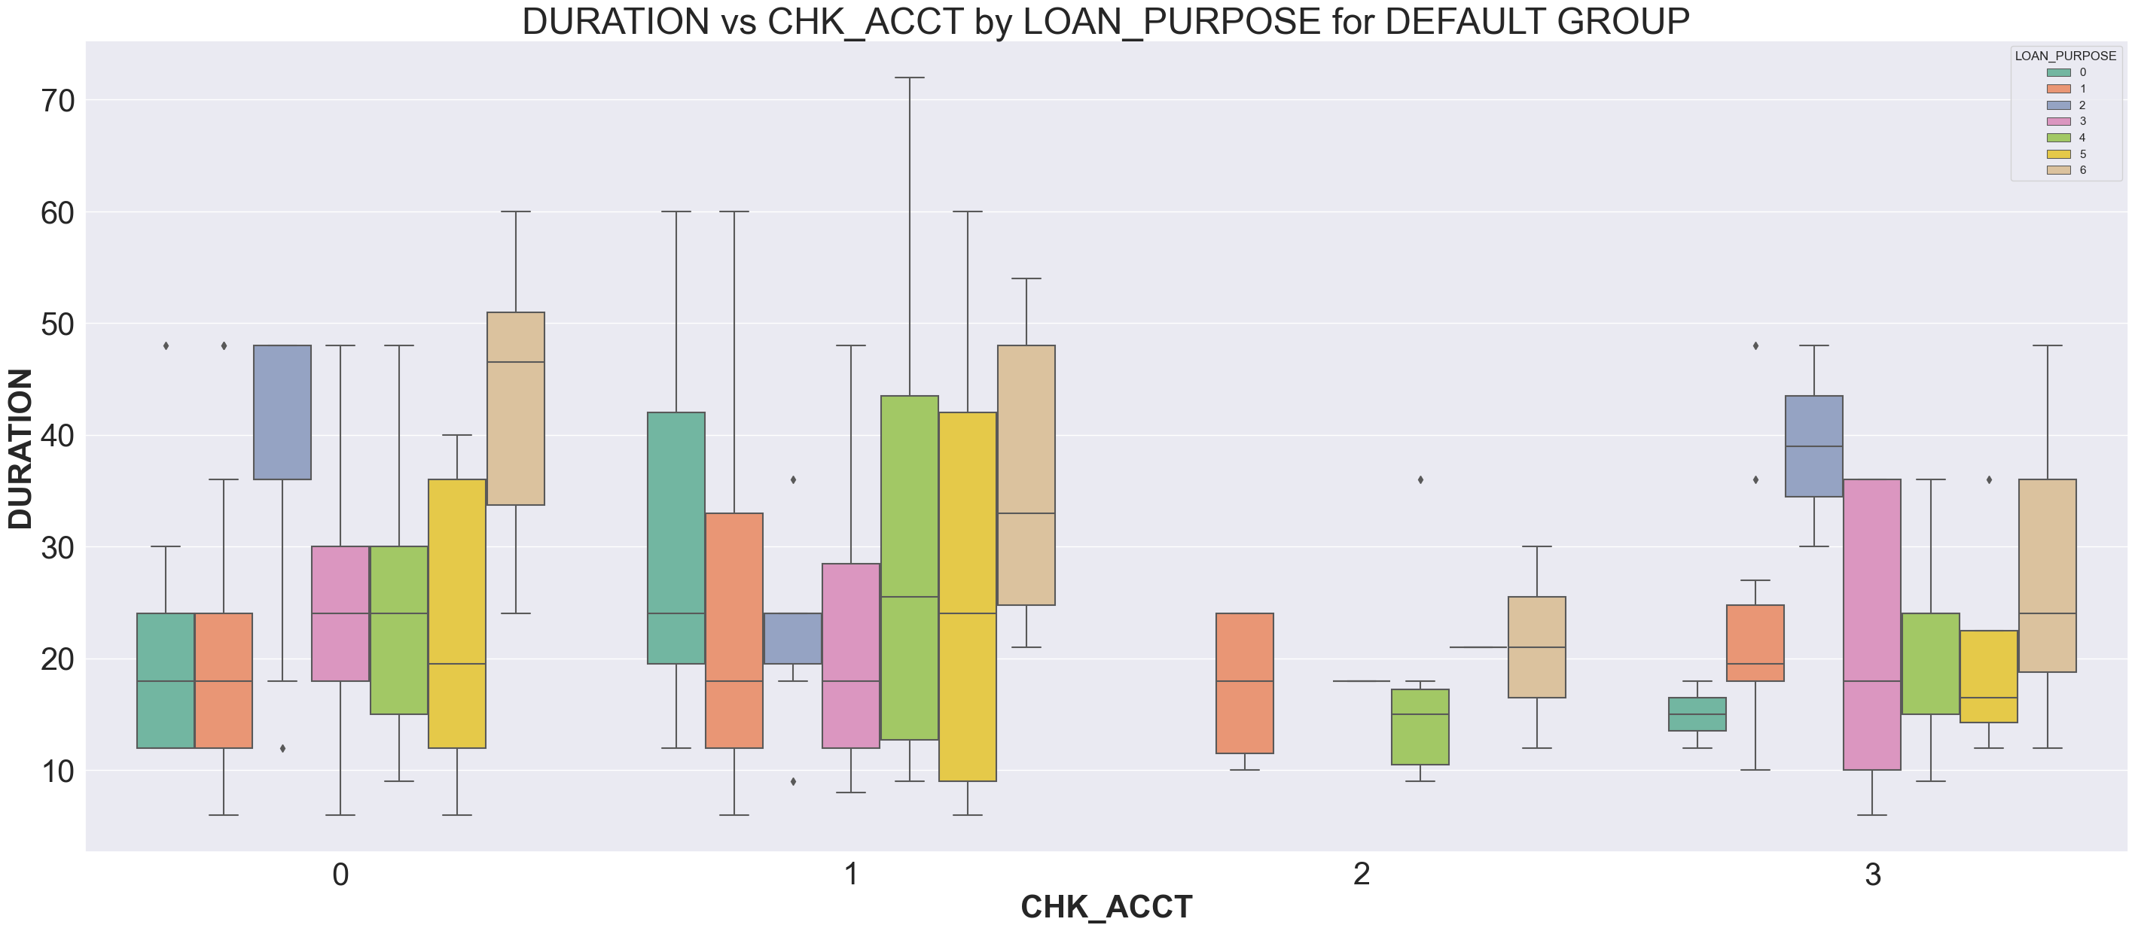
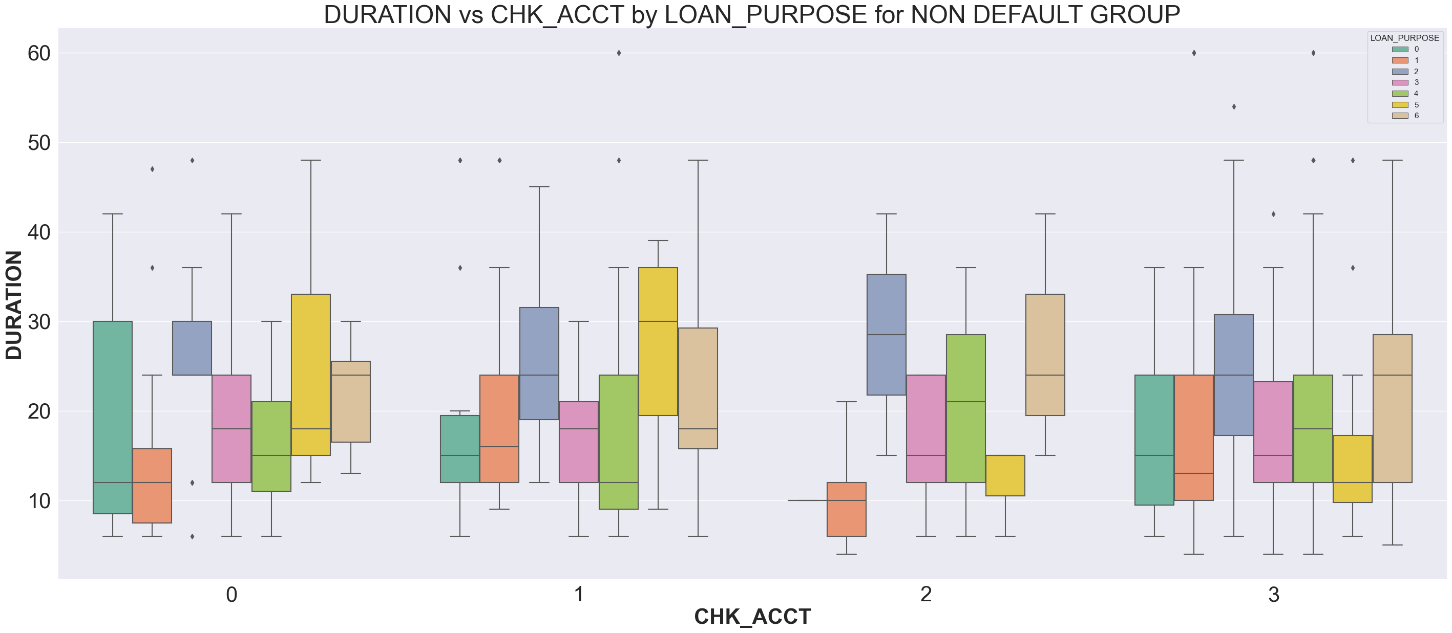
DURATION vs CHECKING ACCT BALANCE vs LOAN PURPOSE by DEFAULT
Description:
Loan Purpose
1: NEW_CAR
2: USED_CAR
3: FURNITURE
4: RADIO/TV
5: EDUCATION
6: RETRAINING
0: OTHERS
Description:
Checking Acct Balance
0 : < 0
1: 0 < ...< 200
2 : => 200
3: no checking account
Individuals without a checking account tend to have shorter loan durations across both default and non-default groups, indicating a preference or qualification for shorter-term loans in this category.
Loan purposes such as new car purchases and education exhibit a wide range of loan durations for those without checking accounts, suggesting that loan purpose plays a significant role in the terms of the loan.
Those with higher checking account balances (over 200) show a broader range and higher median loan durations in the default group, implying a correlation between higher balances and the tendency to opt for longer loan periods.
Notes:
Loan Duration Variances: For both the default and non-default groups, individuals with no checking account (category '3') appear to have loans with shorter durations. This suggests that having no checking account might be associated with opting for shorter-term loans or lenders are offering shorter durations to this category.
Loan Purpose Distribution: The loan duration is fairly consistent across different loan purposes for individuals with positive checking account balances (categories '0', '1', and '2'). However, there's a noticeable variation in the median loan duration for those with no checking account (category '3'), particularly for new car loans (category '1') and education loans (category '5'), which suggests specific loan purposes might be influencing loan term agreements.
Checking Account Influence: In the default group, individuals with balances over 200 (category '2') tend to have a wider spread and higher median loan duration compared to other categories, indicating a potential relationship between higher checking account balances and the willingness or capacity to engage in longer-term loans, which may also carry a higher risk of default.

Slide 25
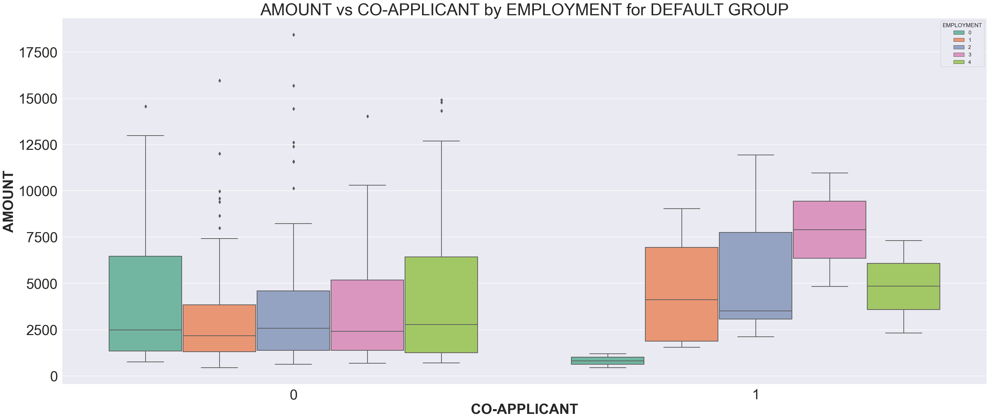
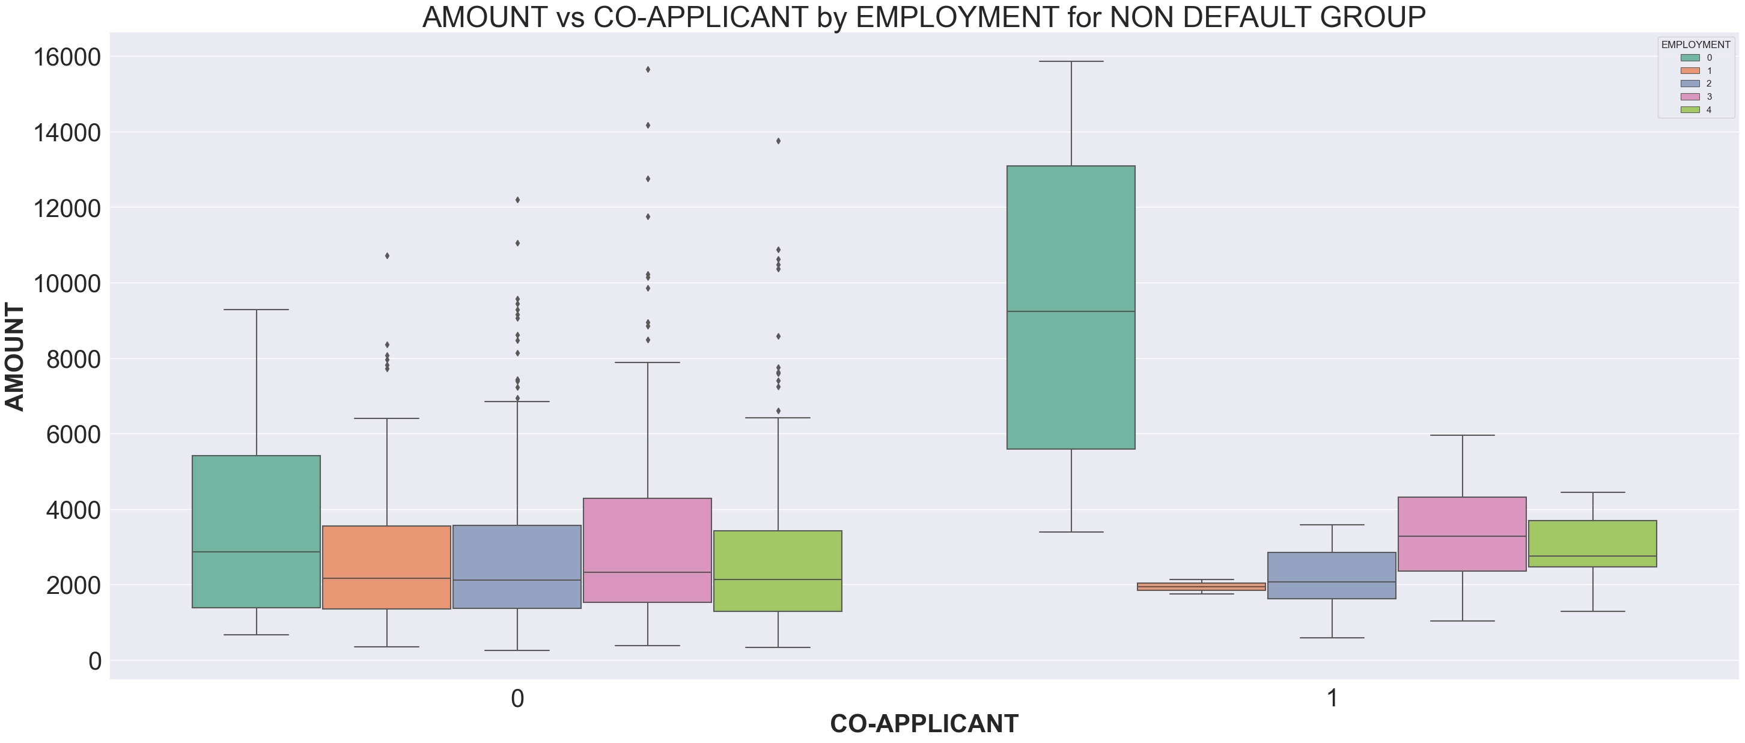
DURATION vs CHECKING ACCT BALANCE vs LOAN PURPOSE by DEFAULT
Description: EMPLOYMENT
0: unemployed/ unskilled – non-resident
1: unskilled – resident
2: skilled employee/ official
3: management/ self-employed/ highly qualified employee/ officer
Description: CO-APPLICANT
Whether an application has a co-applicant
0: No
1: Yes
Non-defaulters receive higher median loan amounts, and the variation in the credit amount is more significant across all employment statuses. In contrast, the default group shows generally lower medians and tighter interquartile ranges, particularly for the unemployed and unskilled non-resident category, indicating more conservative lending likely due to past default behavior.
Clients without Co-applicant primarily fall within the third quartile range and have a lot of outliers, suggesting a preference for higher credit amount in this group.
Notes:
Credit Amount vs Employment Status:
Applicants with co-applicants, regardless of their default status, tend to secure higher loan amounts across all employment categories. This could indicate that lenders are willing to offer more considerable sums when the risk is shared.
Among the default group, individuals without co-applicants who are skilled employees or officials (employment status 2) and management or highly qualified employees (employment status 3) generally receive higher credit amounts compared to unemployed or unskilled non-residents (employment status 0).
Employment Status Influence on Credit for Non-Defaulters:
For the non-default group, the credit amount distribution across different employment statuses indicates a tendency for more substantial loans to be issued to skilled and higher-status employees. This is especially noticeable for employment status 3, which has a higher median and wider interquartile range, suggesting both a willingness to lend more and a diversity in the loan amounts granted.
Default Risk Impact:
Comparing both box plots, non-defaulters receive higher median loan amounts, and the variation in the credit amount is more significant across all employment statuses. In contrast, the default group shows generally lower medians and tighter interquartile ranges, particularly for the unemployed and unskilled non-resident category, indicating more conservative lending likely due to past default behavior.

Slide 26
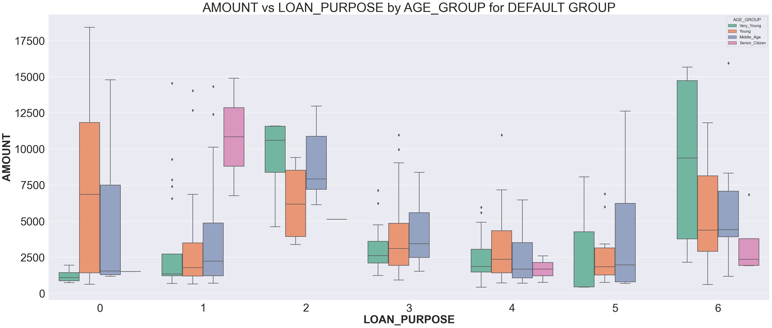
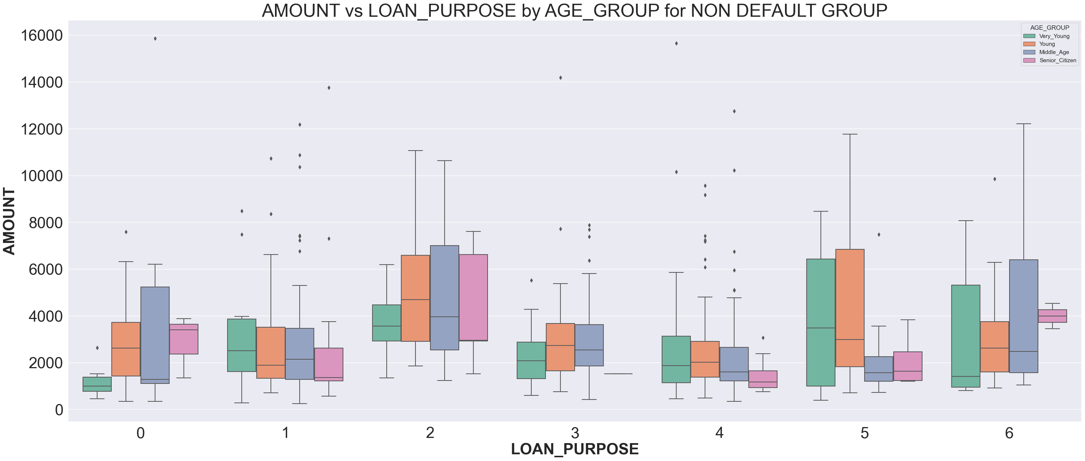
DURATION vs CHECKING ACCT BALANCE vs LOAN PURPOSE by DEFAULT
Description:
Loan Purpose
1: NEW_CAR
2: USED_CAR
3: FURNITURE
4: RADIO/TV
5: EDUCATION
6: RETRAINING
0: OTHERS
For both default and non-default groups, credit amounts are highest for individuals in the "Senior Citizen" category across most loan purposes, indicating that older individuals tend to borrow larger amounts.
"Education" and "Retraining" loan purposes generally show lower median credit amounts compared to other purposes like "New Car" or "Radio/TV", suggesting these loans are typically smaller in size.
The variation in credit amounts (as indicated by the interquartile range and outliers) is significant for "New Car" loans in the default group, which could indicate varying financial situations or risk assessments among borrowers within this category.
Notes:
Senior citizens in the default group tend to have a higher credit amount for almost all loan purposes, with especially notable higher medians in the "New Car" and "Radio/TV" categories. This could suggest that senior citizens either prefer more expensive items or have a longer credit history that allows them access to larger loan amounts. However, this also comes with a substantial amount of variability, as seen by the longer box plot whiskers, indicating that within this group, there's a wide range of amounts borrowed.
In the non-default group, there's a more consistent credit amount across different age groups and loan purposes, with less pronounced differences between the median credit amounts. This could indicate that individuals who do not default are generally borrowing within their means, regardless of the loan's purpose or the age of the borrower.
The "Education" and "Retraining" loan purposes show relatively low median credit amounts across both default and non-default groups, but especially in the non-default group. This may reflect a cautious approach to borrowing for these purposes, which could be due to the potentially uncertain return on investment in one's education or retraining.
The "New Car" loan purpose stands out with relatively high median credit amounts and a wider range of amounts in the default group compared to the non-default group. This suggests that new car loans may be a higher risk, possibly due to borrowers overestimating their ability to repay

Slide 27
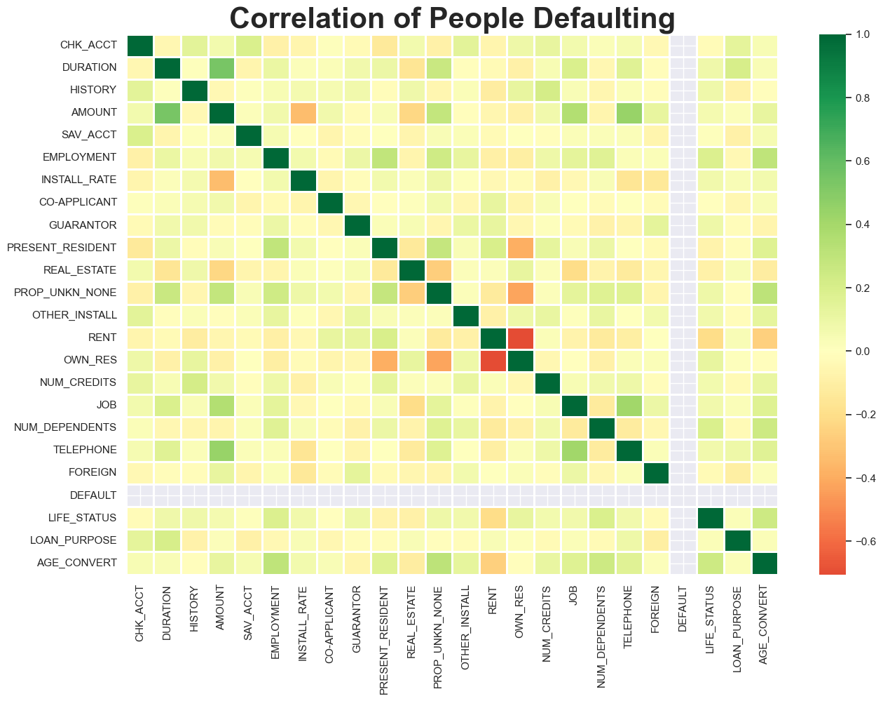
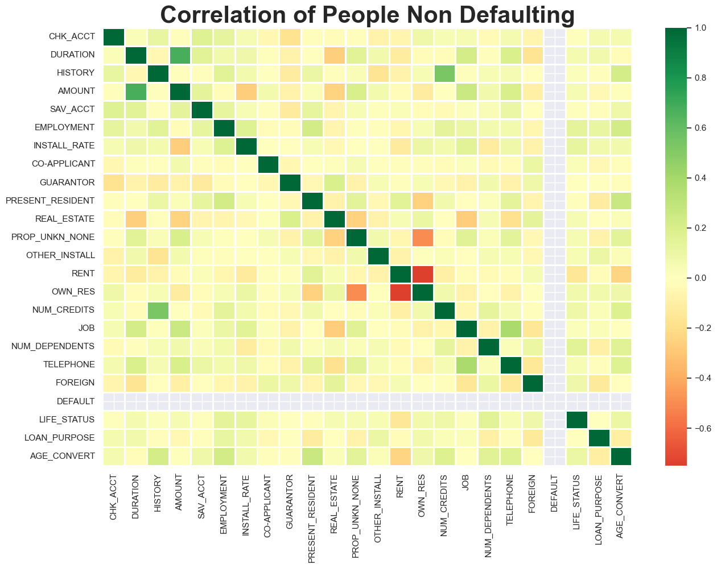
COMPARATIVE CORRELATION ANALYSIS OF DEFAULT AND NON-DEFAULT CUSTOMER PROFILES
The 2 heatmaps show no significant difference of correlations.
Higher credit amounts are typically associated with longer loan period for both repayers and defaulters.
OWN_RES is inversely proportional to RENT, means that those who owns residence are less likely to rent, which makes sense.
NUM_CREDITS is positively correlated to HISTORY, indicates that the more number of existing credits at this bank a client has, the worse they are likely to perform.
PROP_UNKOWN_NONE and OWN_RES are moderately correlated, means if an applicant does not property (or unknown), they are less likely to own residence.

Slide 28
DATA MODELING STEPS
Prepare Data for Modeling
1.1. Split Table into Dependent and Independent Variables
1.2. One-Hot Encoding for Categorical Predictors
1.3. Split Data into Training and Testing Sets
2. Building XGBoost Model
2.1. Initial Model without Hyperparameter Tuning
2.2 Optimizing Parameters using Cross-Validation and GridSearchCV
2.3 Optimal XGBoost Model with Tuned Hyperparameters
3. CHOOSING AN Appropriate threshold
3.1. Conservative threshold to keep false negative rate to below 10%
3.2. Choosing an balanced Threshold

Slide 29
Why XGBOOST?
XGBOOST is often preferred over other methods in the following scenarios:
Large datasets: XGBOOST is optimized for performance and can handle large datasets efficiently.
Feature-rich data: XGBOOST can handle a large number of features and automatically account for feature interactions.
Performance focus: when predictive accuracy is of the utmost importance, xgboost often outperforms other algorithms due to its ability to do extensive search over parameters.
Non-linear problems: XGBOOST is great for datasets where the relationship between the features and the target is complex and non-linear.
Regularized learning: XGBOOST includes built-in l1 (lasso) and l2 (ridge) regularization which can prevent overfitting.
XGBOOST is widely adopted in credit risk modeling due to its ability to handle large datasets efficiently and its superior performance in capturing complex nonlinear relationships within variables. It's also popular because it provides robust results against overfitting and has a variety of regularization features which improve model stability and accuracy.

Slide 30
Prepare Data for Modeling
In order to use categorical data with scikit learn for training, we have to use a trick that converts a column of categorical data into multiple columns of binary values. This trick is called One-hot Encoding.
Since the dataset is imbalanced with only 30% of observations being default, we will split using stratification in order to maintain the same percentage of people who defaulted in both the training set (X_train, Y_train) and the testing set (X_test, Y_test).

Slide 31
Building XGBoost Model

Slide 32
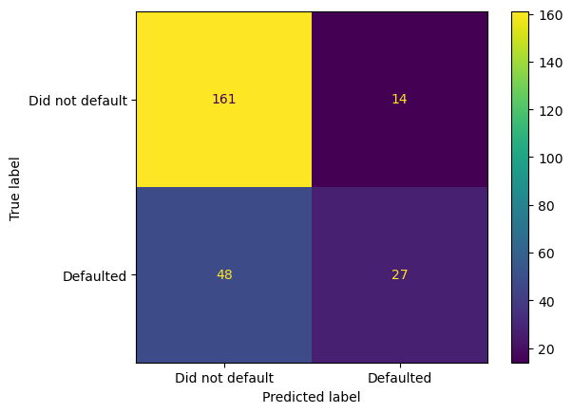
Initial Model without Hyperparameter Tuning
The model is created from 12 decision trees.
188 instances were correctly classified (161 true negatives & 27 true positves), associated with 75%! (Good but is it overfitting?)
However, out of 75 people that defaulted, only 27 (<50%) were correctly classified.
Defaulting on loans costs the company a lot of money, we would like to capture more of the people that defaulted.
We need to use cross validation and hyperparameter tuning to improve predictions and prevent overfitting.

Slide 33
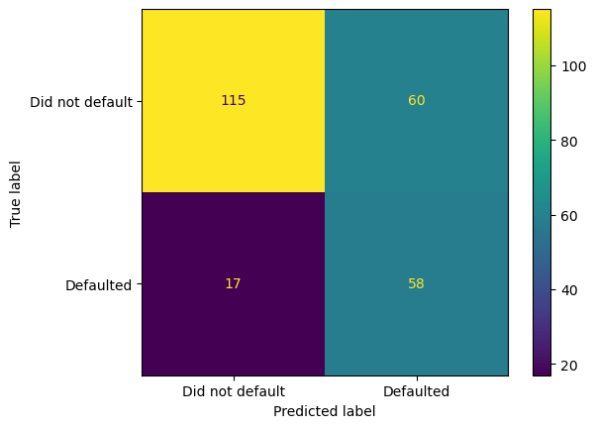
Optimizing Parameters using Cross-Validation and GridSearchCV
The optimized model is created based on 11 decision trees.
173 people were correct classified (including 115 non-defaulted ones and 58 defaulted ones), associated with 69.2%. Also, there is 58 out of 75 defaulted people were correctly classified, associated with 77%.
The optimized model is now much better at correctly classifying people that defaulted. This was at the expense of incorrectly classifying people that did not default, and this tradeoff is something that the company might have to think about. However, from our perspective, this was a success.

Slide 34
CHOOSING AN Appropriate threshold

Slide 35
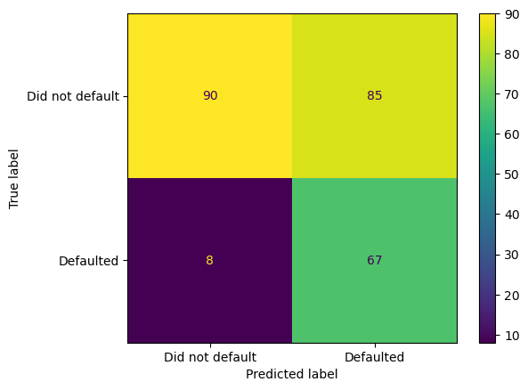
threshold to keep false negative rate to below 10%
In credit industry, we are more concerned with minimizing the wrong classification of true (defaulted) as false (non-defaulted) by lowering false negative rate.
Assume that we aim to lower the false negative rate to below 10% => threshold = 0.437
Only 8 out of the 75 people who defaulted were incorrectly classified.
This adjustment also resulted in a significant rise in the number of people who didn't default being labeled as defaulted.
Strictly keeping FNR < 10%, we'll likely overlook many reliable customers.

Slide 36
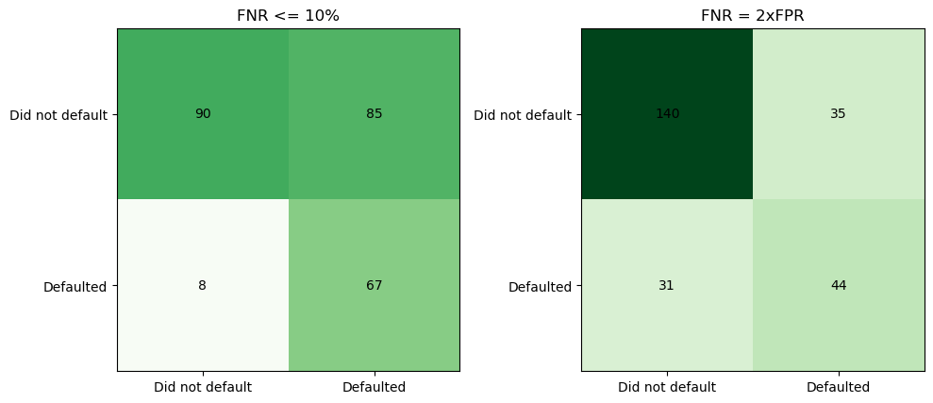
Threshold to obtain a balance overlooking potential good customers and identifying risky ones
Assume that in the past offering credit to a bad customer averagely cost us $30,000 loss and offering credit to a good customer will bring an average profit of $15,000. Then a false negative is twice as costly as a false positive => Threshold = 0.582
With the adoption of a new threshold, misclassification of good customers has significantly decreased to only 35, compared to 85 when a conservative rule aimed to maintain the False Negative Rate (FNR) below 10% was applied.
Conversely, this approach results in 23 more bad customers being incorrectly identified as good (decreasing from 67 correctly identified with the conservative goal to 44 under the balanced business objective).

Slide 37
Conclusion
Choosing a threshold depends on what your business prioritizes.
Setting the threshold in credit risk modeling is a balance between security and customer experience.
A high threshold minimizes the risk of default but may inadvertently reject potential good customers.
A lower threshold optimizes for customer approval rates, accepting a slight increase in false negatives to ensure valuable customers are not turned away.

Slide 38
CREDIT RISK MODELING USING XGBOOST IN PYTHON
by Sandy Vo
Date: Apr 13th 2024
---------------------------------
THE END

